Slide 1
Development of business in LATAM

Slide 2
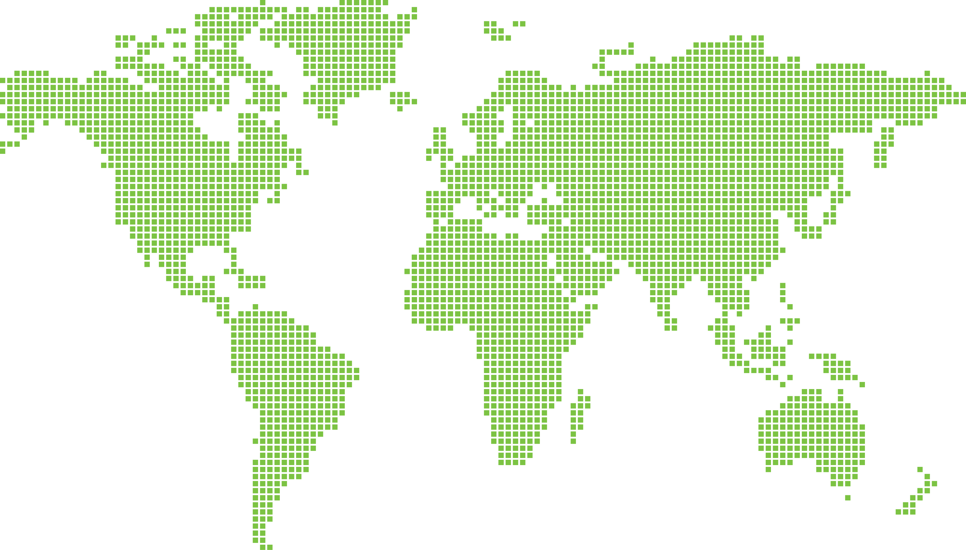

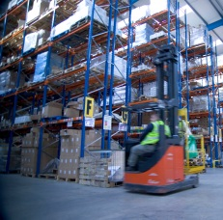
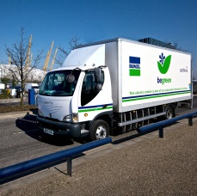
About us
Bunzl is a growing
and successful Group providing outsourcing solutions and value added distribution across the Americas, Europe and Australasia
Source
Consolidate
Deliver

Slide 3
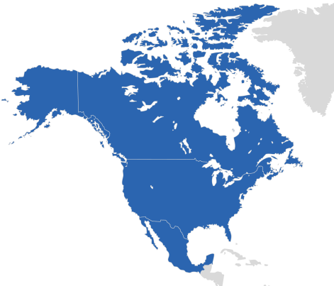
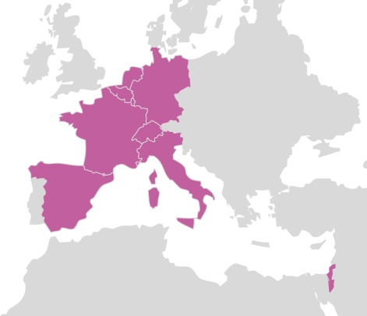
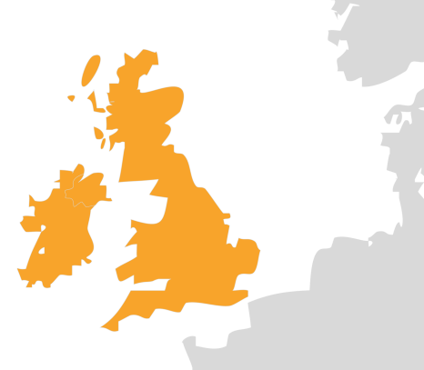
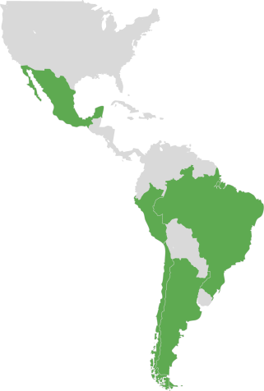

2013 Business area analysis
Well diversified by geography and sector
NORTH AMERICA
CONTINENTAL EUROPE
55%
Revenue
19%
Revenue
49%
Operating profit*
22%
Operating profit*
UK & IRELAND
REST OF WORLD
17%
Revenue
9%
Revenue
17%
Operating profit*
12%
Operating profit*
* Before intangible amortisation and acquisition related costs and corporate costs
Notes:
Source: Prior year FY results presentation

Slide 4
Attractive customer markets
Healthcare
Disposable healthcare consumables, including gloves, swabs, gowns and bandages,
to the healthcare sector.
Other
A variety of product ranges supplied to other markets such as government and education establishments.
Safety
A complete range
of personal protection equipment, including hard hats, gloves,
boots and workwear,
to industrial and construction markets.
Foodservice
Non-food consumables, including food packaging, disposable tableware,
guest amenities, catering equipment, cleaning products and safety items, to hotels, restaurants, contract caterers, food
processors and the leisure sector.
c.75% resilient Grocery Foodservice
Cleaning & hygiene Healthcare
Retail
Goods not for resale, including packaging
and a full range of cleaning and hygiene products, to department stores, boutiques, office supply companies, retail chains and home improvement chains.
Grocery
Goods not for resale (items which
are used but not actually sold), including food packaging, films, labels and cleaning and hygiene supplies, to grocery stores, supermarkets and retail chains.
Cleaning & hygiene
Cleaning and hygiene materials, including chemicals and hygiene paper, to cleaning and facilities management companies and industrial and healthcare customers.
2013 FY Revenue

Slide 5




Entry into Brazil
2008 to 2010 – Brazil market entry
  Protcap – Entry into safety sector
  AM Supply – Expansion in safety sector
COLOMBIA
First entry into Latin America by anchor acquisition in Brazil safety sector in 2008
BRAZIL
PERU
BRAZIL
2011 – Expansion in Brazil
CHILE
  Ideal – Entry into cleaning & hygiene sector
  Danny – Expansion in safety sector
ARGENTINA

Slide 6







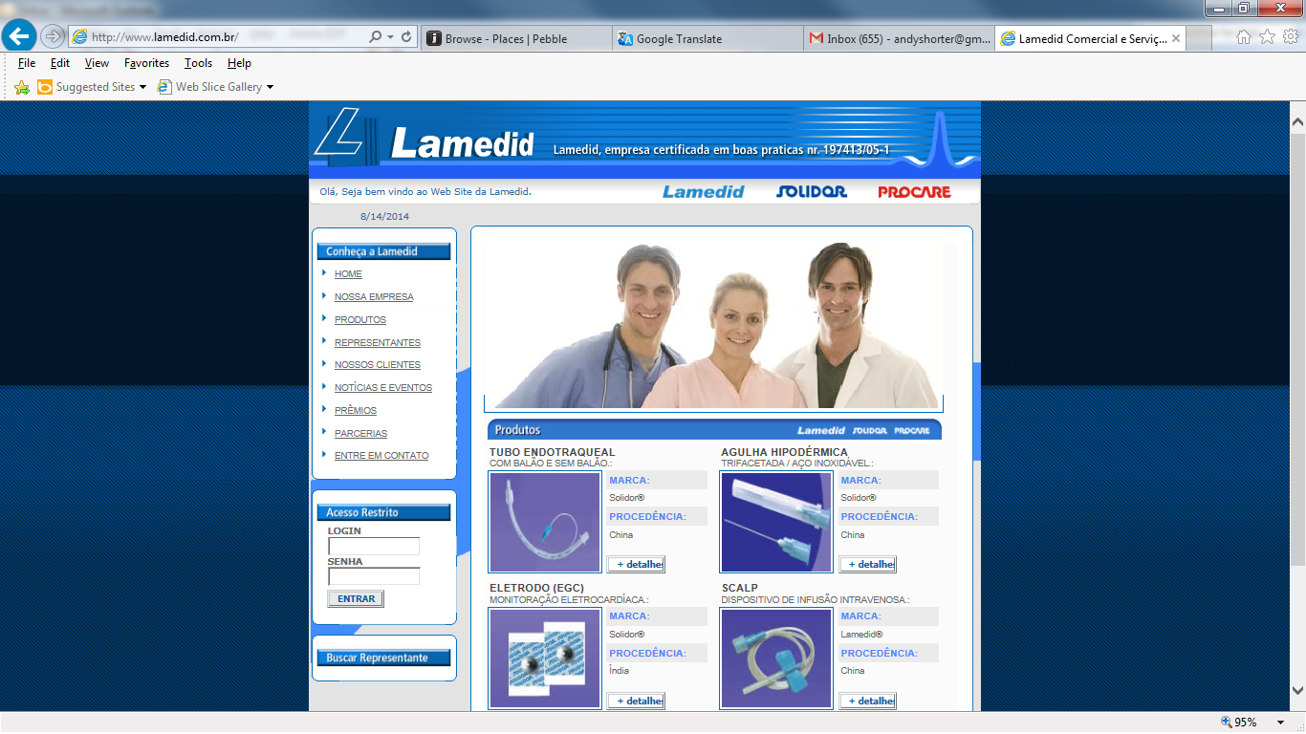
Development of LATAM
MEXICO
2012 – Expansion outside Brazil
  Vicsa – Entry into safety sector in Chile, Colombia, Peru, Argentina and Mexico and expansion in Brazil
COLOMBIA
2013 – Consolidation
12
anchor and bolt-on acquisitions since 2008
BRAZIL
  Labor – Entry into healthcare sector in Brazil
  Espomega – Major expansion in safety sector in Mexico
  De Santis – Expansion in safety sector in Brazil
PERU
BRAZIL
CHILE
ARGENTINA
2014 – Platform for future growth
  Tecno Boga – Safety shoes in Chile
  JPLUS – Cleaning & hygiene in Brazil
  Lamedid – Laboratory supplies in Brazil

Slide 7
Strong growth in LATAM
Revenue
Lamedid
Tecno Boga
JPLUS
Labor
Espomega
ProEpta
De Santis
Ideal
Danny
Vicsa
Annualised revenue now £234m with CAGR of
30%
Prot-Cap
AM Supply
Safety
Cleaning &
hygiene
Foodservice
Healthcare
Retail

